Slide 1


WAVECON TELECOM ANALYSIS
PRESENTED BY:
PRIYANKA GUNDAYE

Slide 2

ABOUT WAVECON
In May 2022, Wavecon, a leading telecom provider in India, launched its 5G services alongside other major telecom companies across key cities.
This analysis examines Wavecon's 5G rollout in 15 major urban centers, focusing on its impact on revenue, plan performance, and critical KPIs.
The insights gained will inform strategic decisions for future growth and optimization.

Slide 3
OBJECTIVES
What is the impact of the 5G launch on our revenue?
Which KPI is underperforming after the 5G launch?
After the 5G launch, which plans are performing well in terms of revenue? Which plans are not performing well?
Is there any plan affected largely by the 5G launch? Should we continue or discontinue that plan?
Is there any plan that is discontinued after the 5G launch? What is the reason for it?

Slide 4
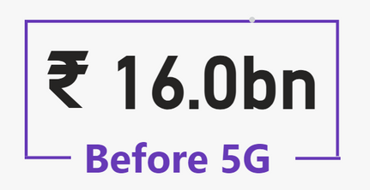

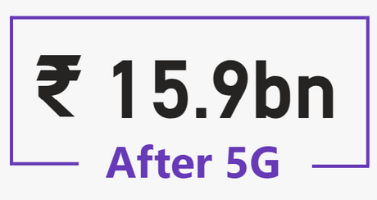
WHAT IS THE IMPACT OF THE 5G LAUNCH ON OUR REVENUE?
Prior to the 5G launch, revenue stood at $16 billion, but it saw a slight decrease to $15.9 billion afterward.
Following the 5G launch, revenue saw a slight uptick in Lucknow, Gurgaon, and Patna. However, Ahmedabad, Chennai, and Delhi experienced a decline in revenue.

Slide 5



WHICH KPI IS UNDERPERFORMING AFTER THE 5G LAUNCH?
Total revenue saw a modest decline, dropping from $16 billion to $15.9 billion.
Meanwhile, the active user base fell from 84.4 million to 77.4 million.
Number of unsubscribed users rose from 5.6 million to 7 million.

Slide 6


AFTER THE 5G LAUNCH, WHICH PLANS ARE PERFORMING WELL IN TERMS OF REVENUE? WHICH PLANS ARE NOT PERFORMING WELL?
Following the 5G rollout,
Plan 1: Smart Recharge Pack (2 GB/Day Combo for 3 months)
Plan 2: Super Saviour Pack (1.5 GB/Day Combo for 56 days)
Plan 11: Ultra Fast Mega Pack (3 GB/Day Combo for 80 days)
stood out as top performers, showing strong revenue growth.
Conversely,
Plan 5: Rs. 99 Full Talktime Combo Pack
Plan 6: Xstream Mobile Data Pack (15GB Data for 28 days)
Plan 7: 25 GB Combo 3G/4G Data Pack
saw a decline in revenue following the 5G launch.

Slide 7
IS THERE ANY PLAN AFFECTED LARGELY BY THE 5G LAUNCH? SHOULD WE CONTINUE OR DISCONTINUE THAT PLAN?
Positively affected plans :
Plan 1: Smart Recharge Pack (2 GB/Day Combo for 3 months):
This plan saw a substantial revenue increase from $1.8 billion to $2.4 billion.
Plan11:Ultra Fast Mega Pack (3 GB/Day Combo for 80 days) & Plan12:Ultra Duo Data Pack (1.8 GB/Day Combo for 55 days)
This newly launched plan achieved revenue of $1.9 billion and $1.2 billion respectively.
Negatively affected plans :
Plan 7: 25 GB Combo 3G/4G Data Pack
This plan saw a notable revenue decline, dropping from $582.40M to $ 155.60 M.
Recommendation:
Given the strong revenue performance of Plans 1,11,12, it is advisable to continue promoting these plans and possibly expand their features or duration to capitalize on their success. Consider analyzing customer feedback and usage patterns to optimize these plans further and potentially develop similar offerings to enhance overall performance.
Evaluate the possibility of discontinuing or reconfiguring plan 7 to align more effectively with the 5G infrastructure and customer demands, given its significant decrease in revenue.

Slide 8
IS THERE ANY PLAN THAT IS DISCONTINUED AFTER THE 5G LAUNCH? WHAT IS THE REASON FOR IT?
Three plans were discontinued following the 5G launch:
Plan 8: Daily Saviour (1 GB/Day) Validity: 1 Day
Reason: A 1 GB data plan with just a 1-day validity is inadequate given the increased data consumption driven by faster 5G speeds. The demand has shifted towards plans offering more data and longer validity, making such limited plans impractical.
Plan 9: Combo TopUp (14.95 Talktime and 300 MB Data)
Reason: With the advent of 5G, consumer preferences have moved away from plans with limited talk time and minimal data. The significant rise in data consumption due to 5G speeds has rendered such minimal offerings less valuable, especially since Wavecon now provides the Rs. 99 Full Talktime Combo Pack.
Plan 10: Big Combo Pack (6 GB/Day) Validity: 3 Days
Reason: Although this plan provided a large data allowance, its short 3-day validity made it less attractive to consumers. This limited duration likely contributed to the decision to discontinue the plan.

Slide 9
RECOMMENDATIONS
Expand Plan Options:
The company should introduce a range of new plan options to cater to the diverse needs and preferences of consumers, ensuring greater flexibility and satisfaction.
Optimize Underperforming Plans for Revenue Growth:
Analyze plans with lower performance, such as Plan 5, Plan 6, and particularly Plan 7, to identify areas for improvement. Consider revising pricing strategies or modifying plan features to enhance revenue.
Leverage Success and Plan for Future Expansion:
Given that Plan 1 has been a top performer before and after the 5G launch, and the new Plan 11 and Plan 12 have also shown strong results, the company should consider developing additional plans similar to these successful ones.
Address TUSU Changes:
While most cities have shown positive TUSU changes, Mumbai experienced a decline of -12.36%. Cities like Lucknow, Pune, and Jaipur have seen significant increases (over 50%). This discrepancy may be due to inadequate network coverage. The company should investigate these areas and develop targeted strategies to address coverage issues and improve overall performance.

Slide 10
THANK YOU

